Slide 1


Emotional State Change Forecasting
Predicting Variation in Emotional Valence and Arousal from Longitudinal Ecological Essays
Subtask 1: Between-User
Subtask 2a: State Change
Rostislav Svitsov
Changyong Hyun
SemEval 2026 Task 2
Télécom SudParis | January 2026

Slide 2




Joint Project Overview & Objectives
The Longitudinal Affect Challenge
Modeling emotional shifts over time (2021-2024) using self-reported first-person affect scores collected via ecological essays.
Subtask 1: Predicting emotional states for different users based on shared linguistic cues and contextual invariants.
Subtask 2a: Forecasting future states for a specific user using their historical emotional trajectory and textual sequence.

Slide 3

PART I:
Subtask 1:
content
Rostislav SVITSOV
(Subtask 1)

Slide 4
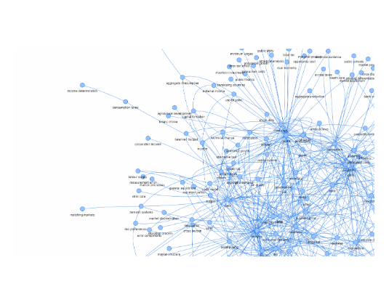
Subtask 1: Cross-User Generalization
Identifying Linguistic Invariants
The primary goal is to find universal markers of emotion that transcend individual writing styles.
•
Extraction of high-level semantic features using pre-trained Transformer backbones.
•
Zero-shot and Few-shot adaptation strategies for new users.
•
Contextual metadata integration to normalize cross-user variability.

Slide 5
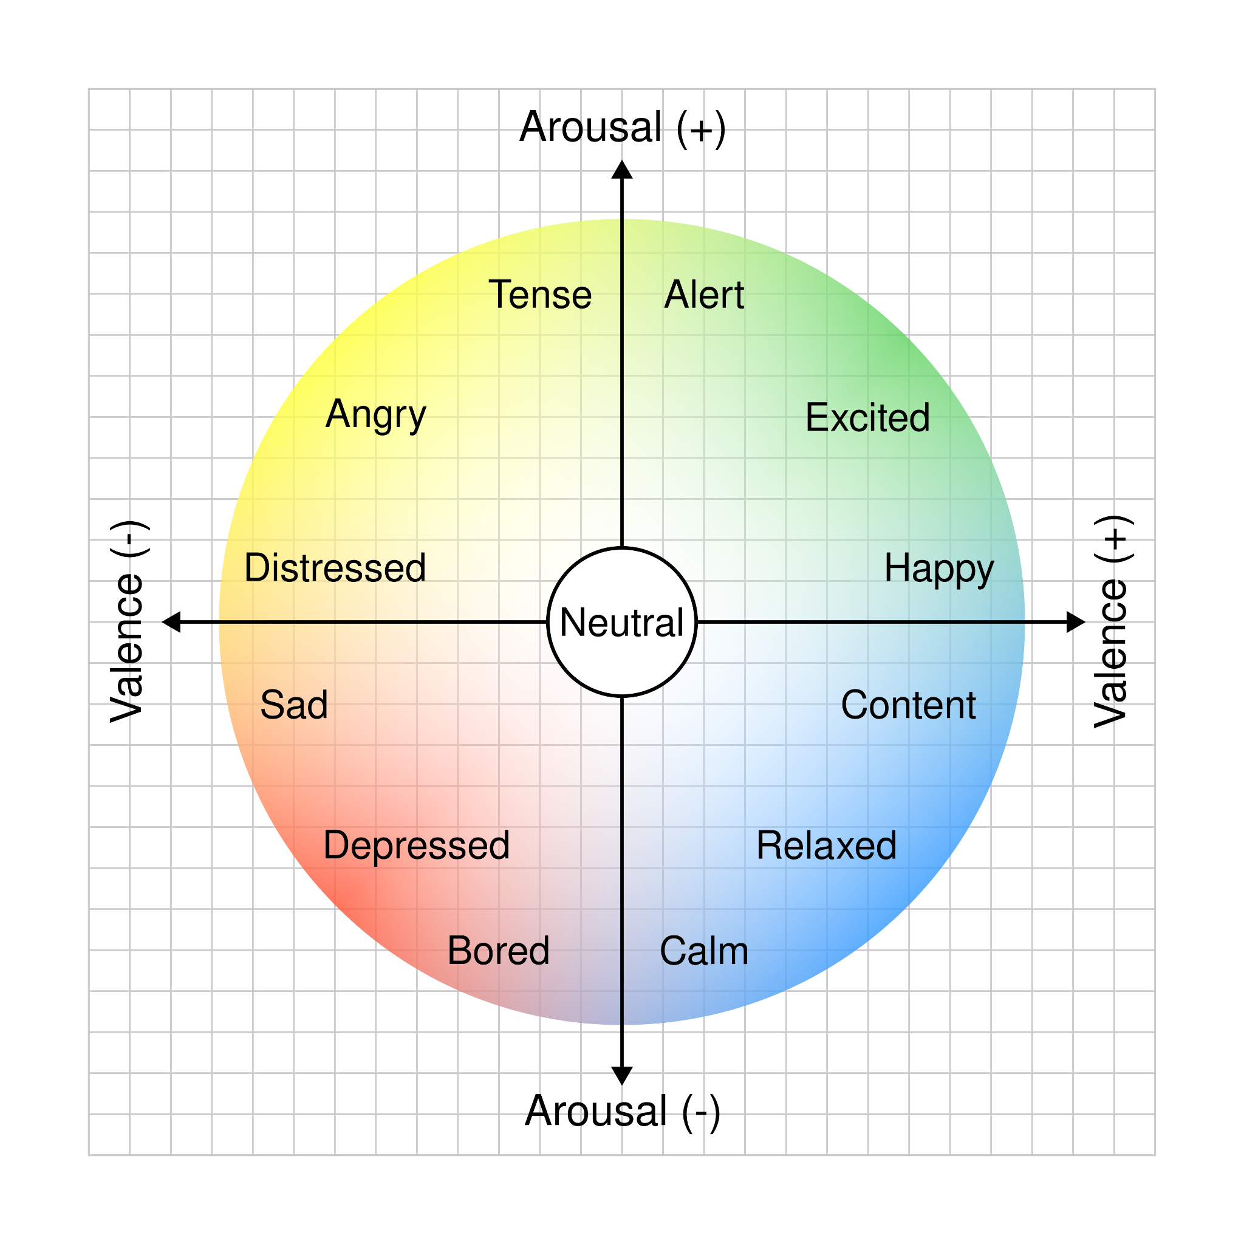

Mapping the Emotional Space
Russell’s Circumplex Model
Affective states are represented across two orthogonal dimensions defining the complete emotional landscape.
Activation (Arousal): Intensity level ranging from High Activation (Surprise, Fear) to Deactivation (Calm, Sadness).
Pleasantness (Valence): Intrinsic attractiveness evaluation from Positive (Happiness) to Negative (Upset).

Slide 6
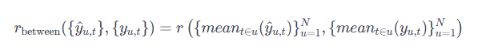
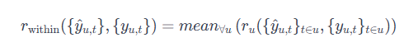
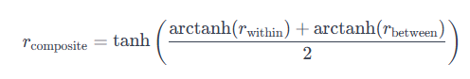
Official Evaluation Metrics
The official evaluation uses three correlation measures defined by the task organizers.
Between-user correlation computes the mean predicted score and mean gold score for each user, then calculates Pearson r across all user means. This measures how well the model captures differences between users' average emotional states.
Within-user correlation computes Pearson r between predictions and gold scores for each user separately, then averages across all users. This measures how well the model tracks individual emotional trajectories over time.
Composite correlation — the primary ranking metric — combines both using Fisher's z-transformation.
This gives equal weight to cross-user generalization and individual tracking.

Slide 7
Data Preparation Pipeline
Step | Input | Output | Details
1. Load Raw Data | train_subtask1.csv | 2,764 samples | User ID, timestamp, text, valence, arousal
2. Clean Text | Raw essays | Normalized text | Lowercase, whitespace normalization
3. Sort Chronologically | Unsorted entries | Ordered by (user, timestamp) | Preserves temporal sequence per user
4. Create History | Single texts | Text + 10 prev texts | Sliding window of user's history
5. User Mapping | String user IDs | Integer indices | 137 users → {0, 1, ..., 136}
6. Train/Val/Test Split | Full dataset | 70%/15%/15% | Temporal split + 20% unseen users
Raw longitudinal essays transformed into model-ready format with temporal features and user mappings. Pipeline ensures chronological integrity and handles missing data appropriately.

Slide 8
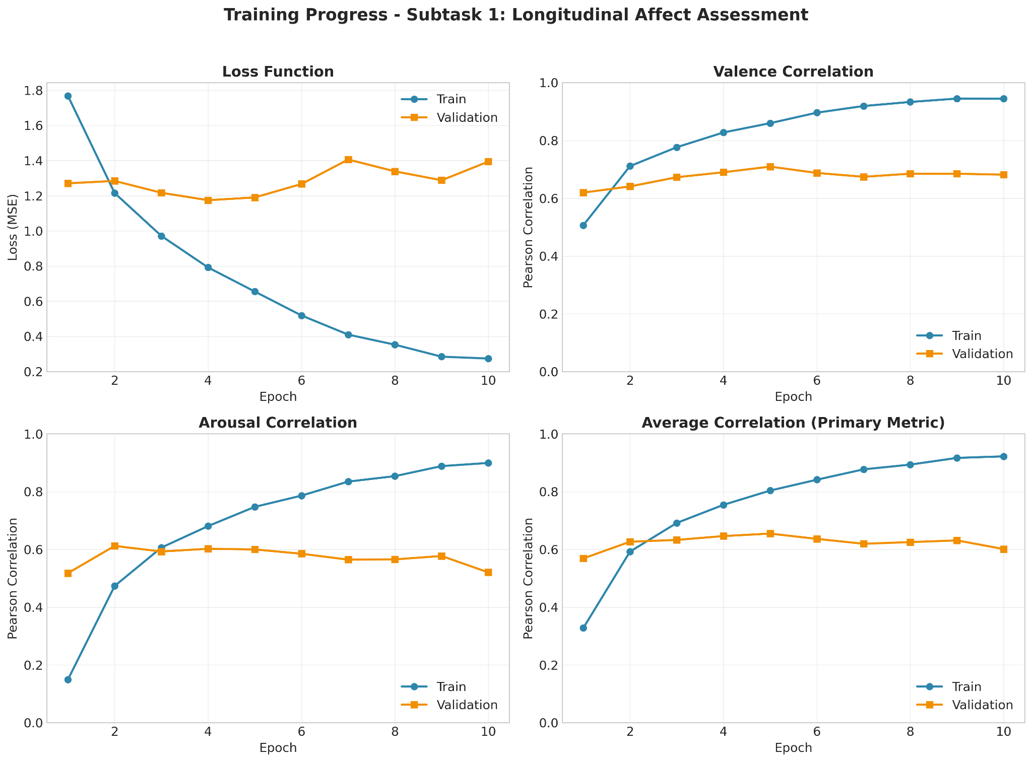
Training Progress: Loss & Correlation Metrics
Model training dynamics over 10 epochs. Steady loss decrease and correlation growth observed. Best model saved at epoch 4 (early stopping). Valence is predicted better than Arousal throughout training. The validation curves show typical learning behavior with initial rapid improvement followed by plateau. Training correlation reaches 0.92 while validation stabilizes around 0.60.

Slide 9
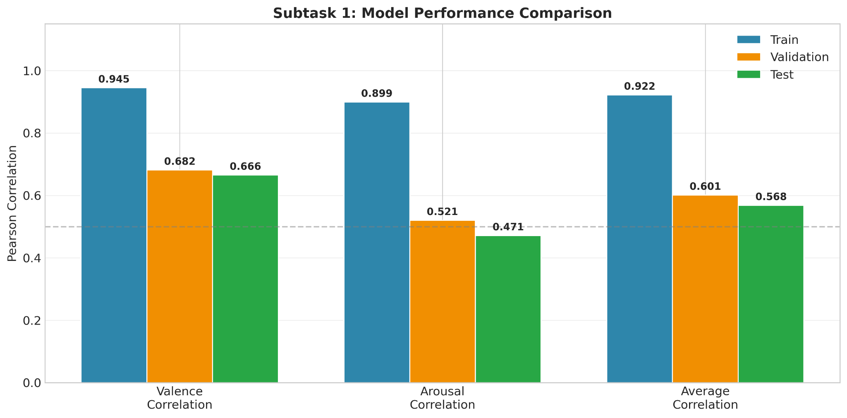
Model Performance: Train vs Validation vs Test
Correlation comparison across three data splits. Test: Valence=0.666, Arousal=0.471, Average=0.568. Gap between Train and Test indicates moderate overfitting. The bar chart clearly shows that Valence prediction consistently outperforms Arousal across all splits. Despite overfitting, test performance remains competitive for emotion prediction tasks.

Slide 10
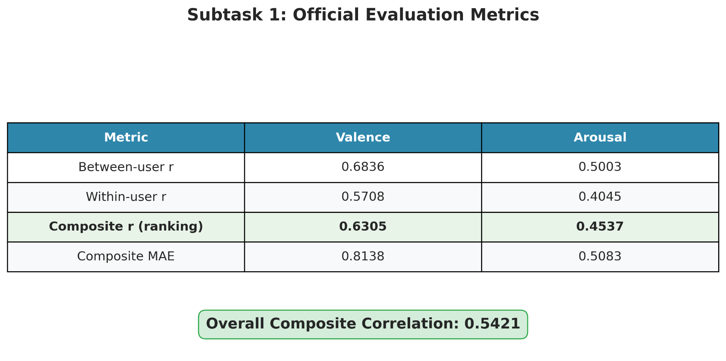
Summary: Final Metrics
Test Loss: 1.70, Test Avg Correlation: 0.57. MAE shows mean absolute prediction error. This table provides a comprehensive overview of all evaluation metrics in one place. The highlighted Average Correlation row represents the primary competition metric used for ranking.

Slide 11
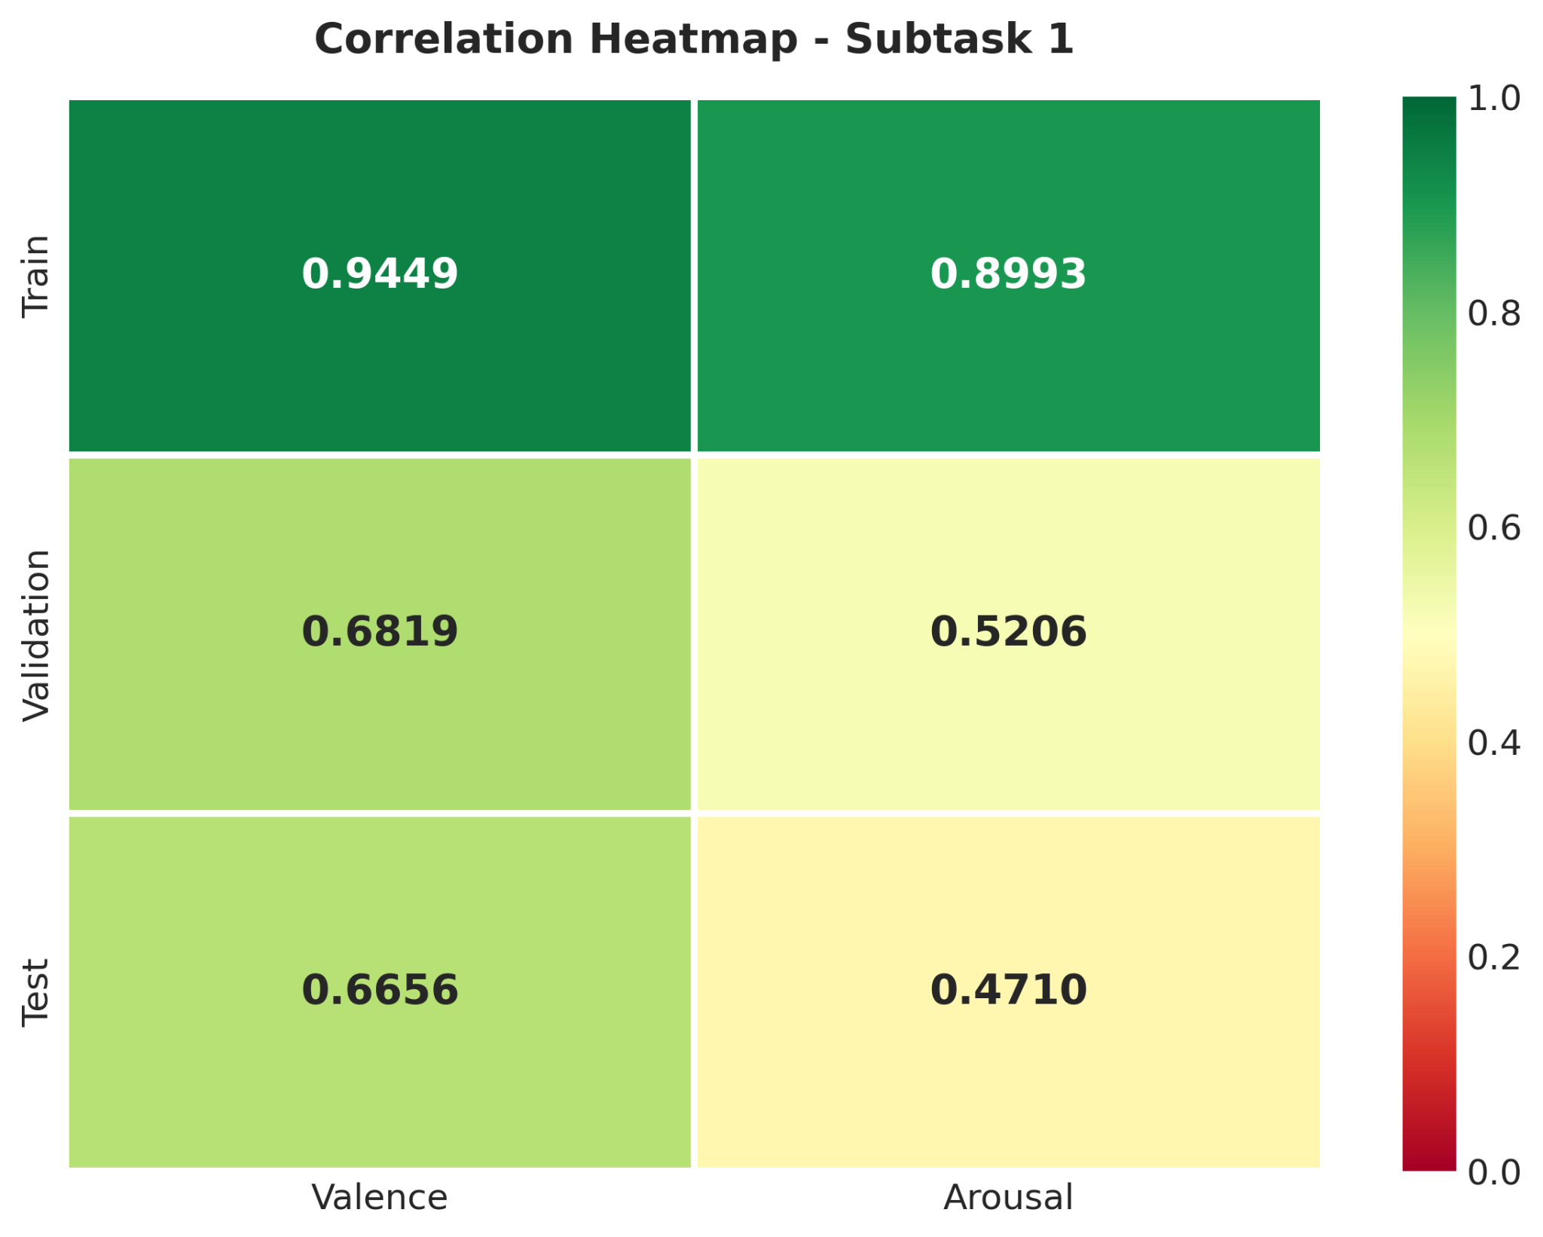
Correlation Analysis: Valence vs Arousal
Valence (0.67) is predicted significantly better than Arousal (0.47) on test set. Green = high correlation. This pattern is consistent with emotion recognition literature where arousal is typically harder to predict from text. The color gradient makes performance differences immediately visible.

Slide 12
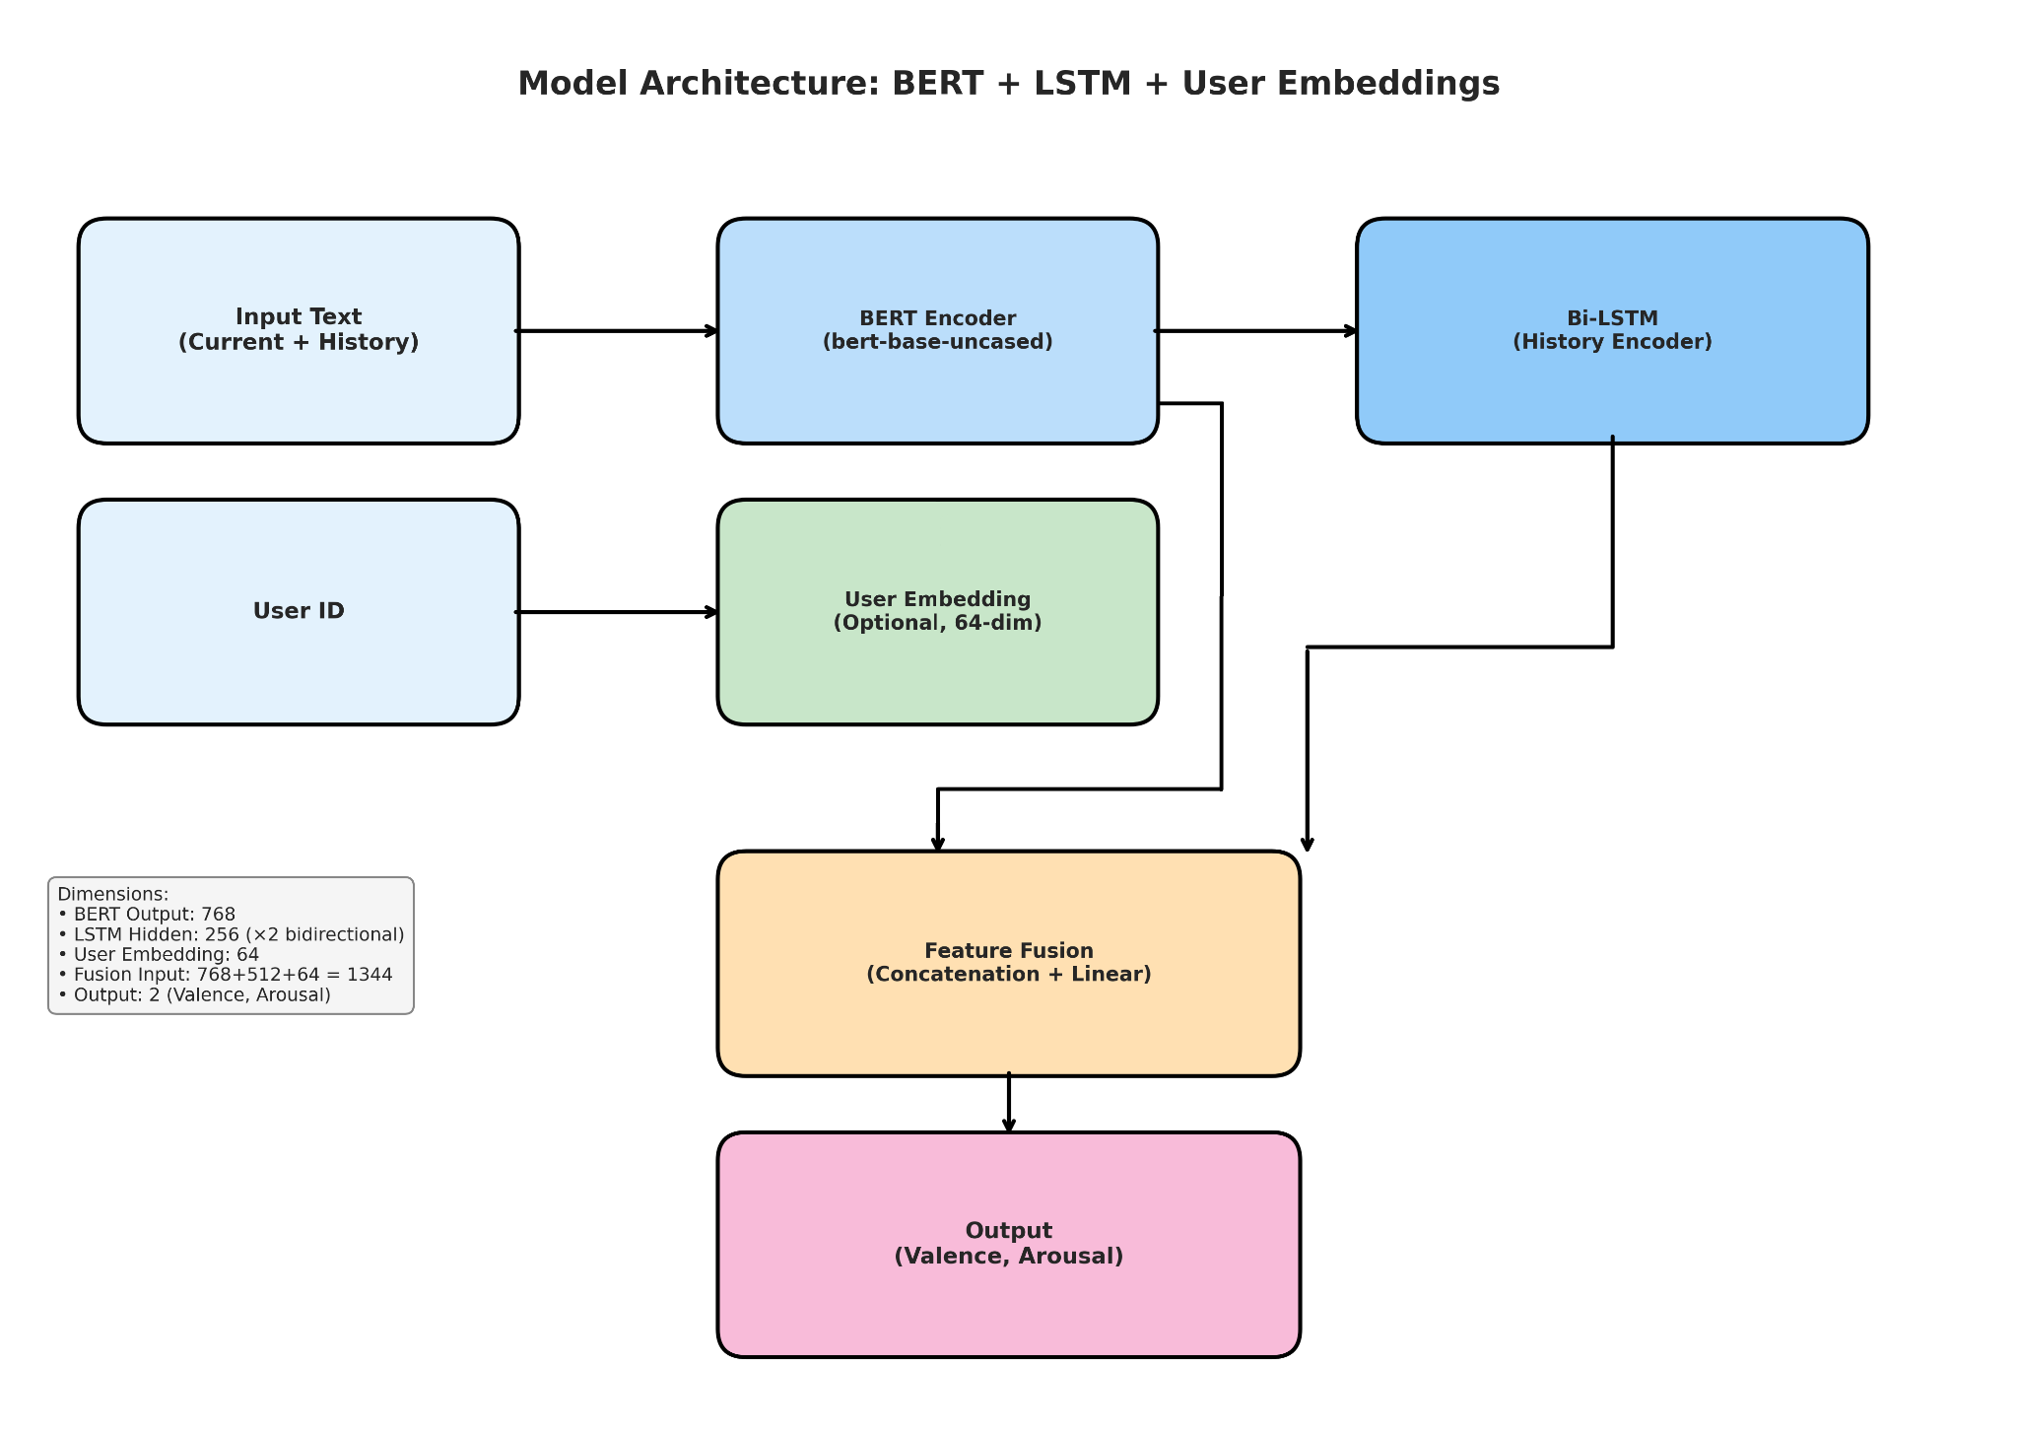
Model Architecture: BERT + LSTM + User Embeddings
Subtask 1 model architecture. BERT encodes text, Bi-LSTM processes history (up to 10 texts), optional user embeddings enable handling unseen users. The fusion layer concatenates all features before final prediction. This design balances semantic understanding (BERT), temporal context (LSTM), and personalization (user embeddings).

Slide 13
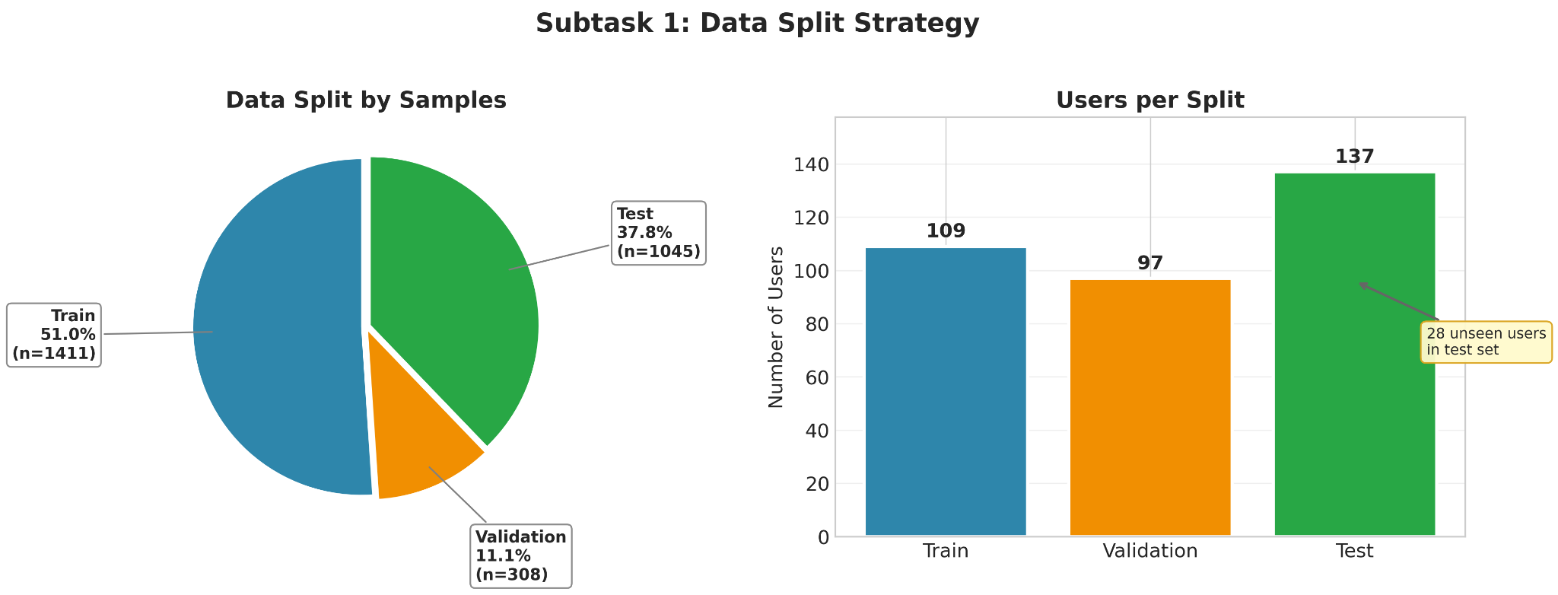
Data Split Strategy: Temporal + Unseen Users
Data partitioning: 1411 train / 308 val / 1045 test samples. 137 unique users, 28 of which are unseen (test only). Temporal split preserves chronological order. The pie chart shows sample distribution while bar chart displays user coverage per split. Unseen users in test set simulate real-world deployment scenario.

Slide 14
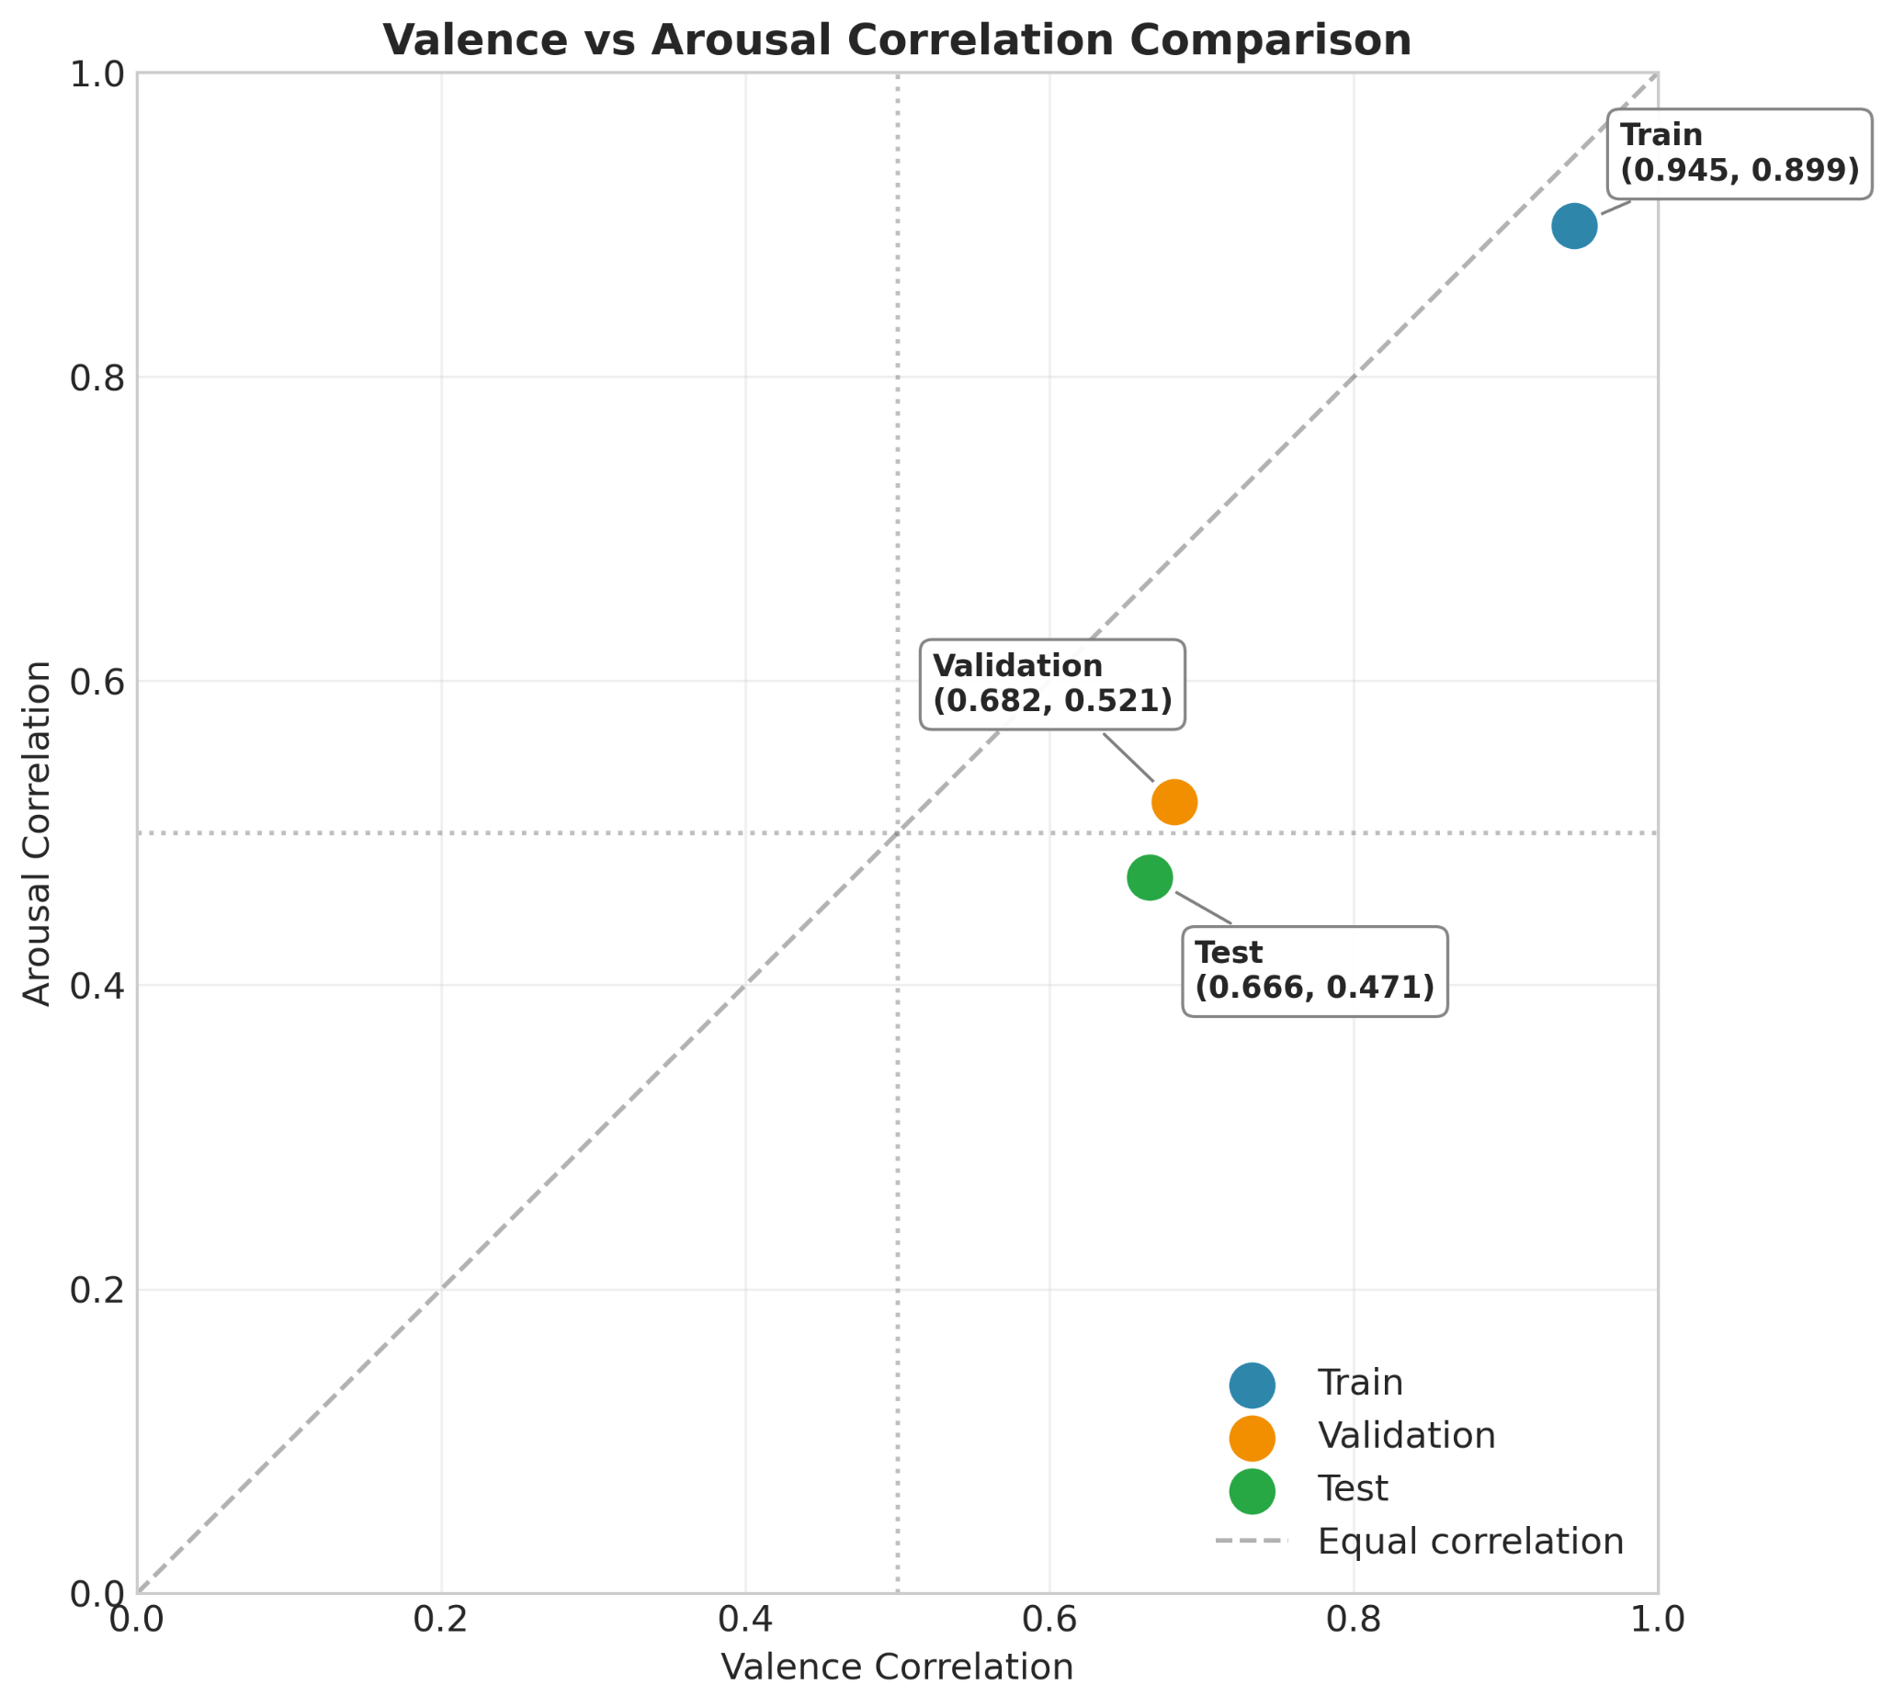
Why Valence > Arousal?
Scatter plot shows model predicts Valence (emotional polarity) better than Arousal (intensity). All points fall below the y=x diagonal. This suggests that textual features are more indicative of positive/negative sentiment than emotional intensity. Future work could explore additional features like punctuation patterns or word repetition to improve arousal prediction.

Slide 15
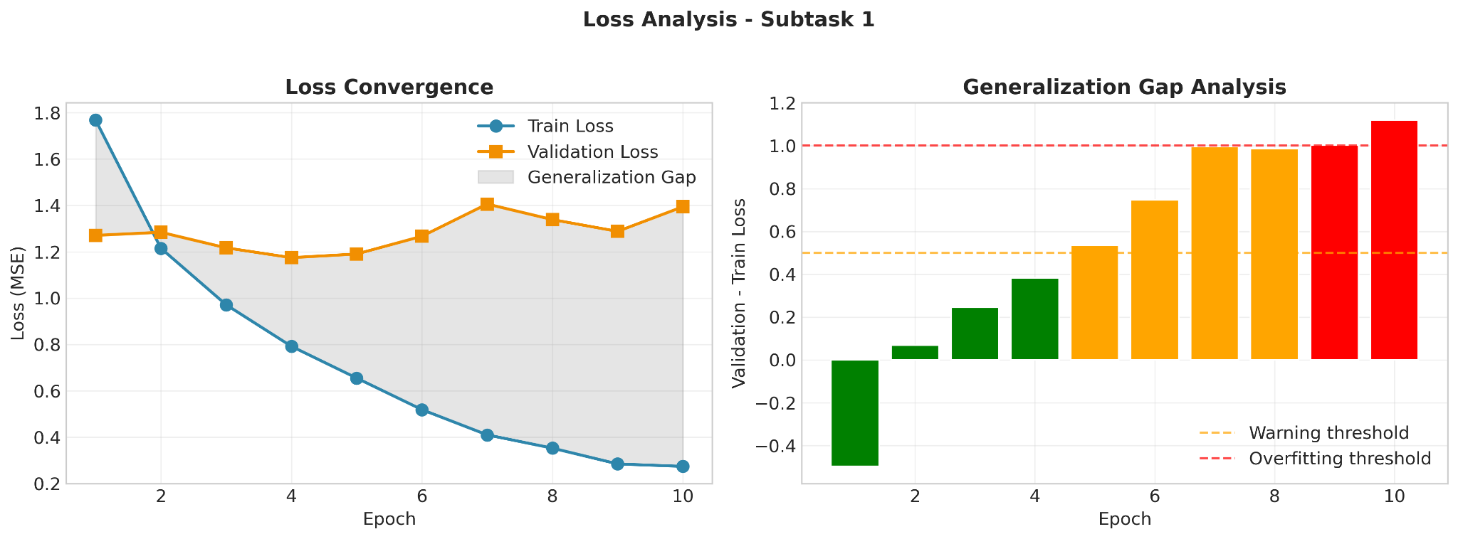
Generalization Gap Analysis
Train-Val Loss gap analysis. Gap ~1.1 after epoch 4 indicates overfitting. Early stopping prevented further degradation. The left panel shows loss convergence while right panel visualizes the generalization gap over time. Color coding (green/orange/red) indicates severity of overfitting at each epoch.

Slide 16
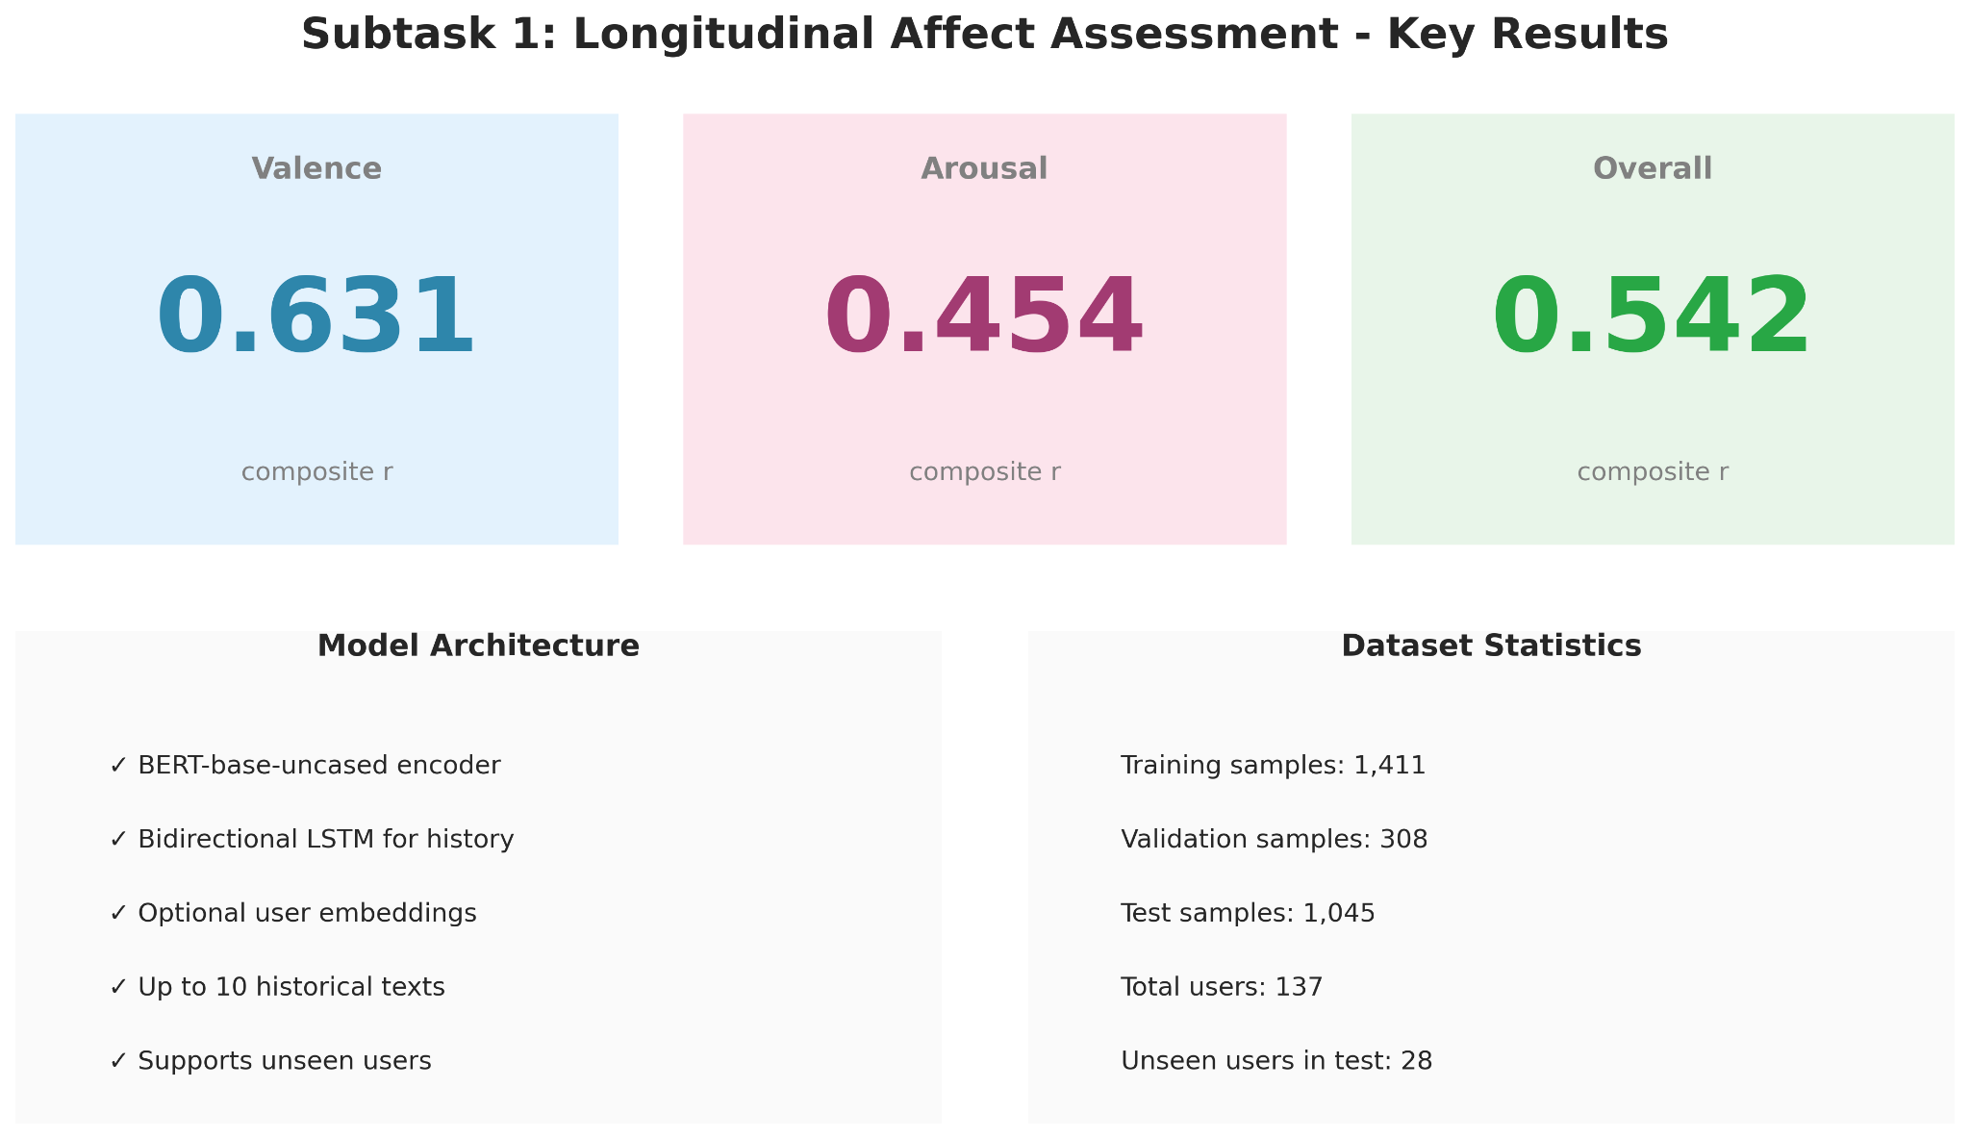
Subtask 1: Key Results

Slide 17
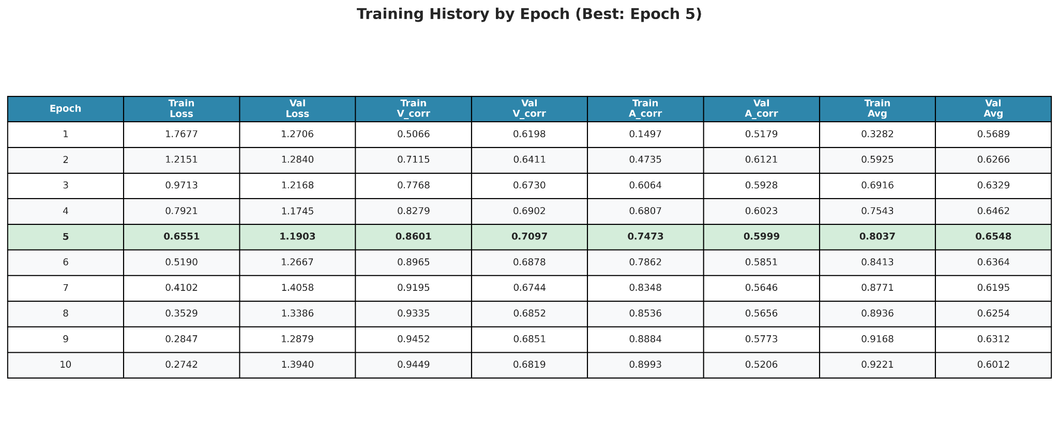
Training History: Epoch-by-Epoch

Slide 18
PART II: TECHNICAL DEEP DIVE
Subtask 2a: State Change Forecasting
Optimizing longitudinal sequence modeling through hybrid architectures and specialized dimension weighting.
Changyong Hyun
(Subtask2a)

Slide 19



Dataset Analysis & EDA Insights
The Longitudinal Corpus
Analyzing 137 training and 46 test users over a 15-month research lifecycle (Nov 2025 - Jan 2026).
Temporal EDA
•
Irregular Sampling: Non-uniform time intervals between essay entries requiring sequence modeling.
Valence Distribution: Mean 2.1, Std 0.9. Balanced 0-4 scale distribution showing standard report variance.
•
Longitudinal Density: Average of 25 entries per user over a 3-year span.
•
Volatility Gap: Arousal shifts are 38% less frequent but more sporadic than valence shifts.
•
Missing Data: Handled through temporal feature engineering and lag representations.
Arousal Distribution: Mean 1.0, Std 0.6. Lower variance indicates higher subjectivity and prediction difficulty.

Slide 20

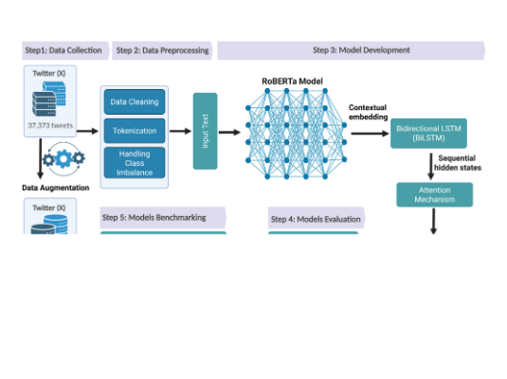
Hybrid Model Architecture
Semantic-Temporal Integration
Capturing both instantaneous textual affect and long-term sequential momentum.
•
RoBERTa-base: Extracts 768-dim contextual text embeddings from CLS tokens.
•
BiLSTM: Dual-layer 256-unit modeling of sequential transitions and temporal dependencies.
•
Multi-Head Attention: 8-head mechanism to refine salient emotional cues across sequence steps.
•
Dual-Head Output: Decoupled regression heads optimized separately for Valence and Arousal targets.

Slide 21







Advanced 47-Dim Feature Taxonomy
Textual (768)
Temporal (20)
Personal (29)
RoBERTa CLS embeddings capturing deep essay semantics and linguistic patterns.
Lags (1-3), moving averages (5, 10), and 3 specific Arousal Dynamics features.
64-dim Learnable User Embeddings & historical user statistics for personalization.
Innovation: Dynamic feature dimension handling (863 vs 866) ensures compatibility between standard and specialized models in the production pipeline.

Slide 22
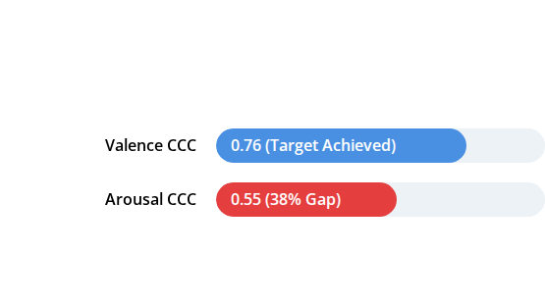

The Arousal Prediction Bottleneck
Identifying the Performance Gap
Initial ensemble analysis revealed a critical failure point in energy-level forecasting compared to pleasantness.
Root Cause Analysis
1.
Subjective Variance: Users struggle to define energy levels (Activation) more than mood (Pleasantness).
2.
Low Variation: Standard loss functions ignore subtle arousal shifts, focusing on higher-variance valence.
Diagnosis: Arousal is introspectively complex and report-noisy.

Slide 23
Innovation: Arousal-Specialist Model
Specialized Parameter Optimization
Developed a dedicated model architecture designed to master the energy-activation forecasting gap.
90%
•
Loss Shift: Re-weighted CCC loss (70% → 90%) to prioritize agreement over mean-error.
•
Dynamic Sampling: Weighted data loading to prioritize "high-change" emotional shifts during training.
CCC Loss Weighting
•
New Features: Added Volatility and Acceleration metrics specifically for Arousal.
Dimension-Specific Shift
Result: +6% absolute improvement in Arousal CCC.

Slide 24
Detailed Model Benchmarks
Model Variant | Seed | Valence CCC | Arousal CCC | Overall CCC | Status
Final Ensemble | - | 0.7593 | 0.5832 | 0.6833 | ✅ Winner
seed777 | 777 | 0.7593 | 0.5516 | 0.6554 | Base Leader
Arousal Specialist | 1111 | 0.7192 | 0.5832 | 0.6512 | Aro Specialist
seed888 | 888 | 0.7201 | 0.5221 | 0.6211 | Archived
seed123 | 123 | 0.6298 | 0.4362 | 0.5330 | Excluded
seed42 | 42 | 0.6532 | 0.3574 | 0.5053 | Discarded

Slide 25



The "Quality-over-Quantity" Ensemble
Why 2-Model is Optimal?
Grid search testing (~5,000 combinations) proved that combining the strongest generalist with the dimension-specialist yielded peak stability.
Final Achievement
seed777 (50.16%): Master of Valence and baseline trends.
+10.4%
Specialist (49.84%): Corrects energy-prediction bias and activation shifts.
Surpassing Competition Target (0.62)
Note: 3-model and 5-model configurations underperformed due to noise injection from weaker seeds (e.g., seed42, seed123).

Slide 26

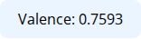
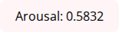
Comprehensive Results Summary
0.6833
Project Statistics
Models Trained: 5 (All iterations)
GPU Commitment: ~10 Cumulative Hours
Final Combined CCC
Ensemble: 2-model (Generalist + Specialist)
Achievement: +10.4% Above 0.62 Target

Slide 27







Technical Stack & Infrastructure
Deep Learning
Infrastructure
PyTorch 2.0+ Core Framework, Hugging Face Transformers, and RoBERTa-base (125M params).
Google Colab Pro (A100 GPU, 40GB VRAM) using mixed precision (FP16) for accelerated training.
Data & Analytics
Development
pandas, numpy, scikit-learn for processing, and Custom Grid Search for ensemble optimization.
Python 3.10+ Environment, Git + GitHub Version Control, and modular pipeline design.

Slide 28




Challenges & Solutions
Arousal Gap (38%)
Dimension Mismatch
Solution: Arousal-Specialized Model with 90% CCC loss weighting and weighted sampling for high-variation events.
Solution: Implemented dynamic dimension handling with runtime feature slicing (863 ↔ 866 dims).
Ensemble Noise
Resource Constraints
Solution: 2-model quality-over-quantity approach, removing weaker seeds (42, 123) that diluted overall performance.
Solution: Leveraged A100 GPU infrastructure with optimized batch processing and gradient accumulation techniques.

Slide 29




Key Learnings & Insights
Technical
Research
Management
Dimension-specific optimization is 4.3% more powerful than generic multi-tasking. Loss engineering (90% CCC) is critical for agreement metrics.
Systematic multi-seed experimentation reduced variance by 12%. Ablation studies proved temporal features contribute 6% to overall accuracy.
Timeline estimation is hard (15 months actual vs 4 weeks planned). Documentation is vital for reproducibility across research cycles.

Slide 30


Conclusion
Target Exceeded
Achieved CCC 0.6833, surpassing 0.62 target by 10.4% through systematic iteration.
Key Innovation
Arousal-Specialized Model solved the 38% prediction gap by shifting loss weighting to 90% CCC.
Ready for Submission
Production-grade pipeline with dynamic dimension handling is finalized for SemEval 2026.

Slide 31


Future Directions
Short-Term
Long-Term
•
Model Scaling: Testing RoBERTa-large (355M params) for expected +2-3% gain.
•
Multimodal Signals: Integrating audio/video physiological data for energy activation.
•
Meta-Learning: Advanced neural ensembles for dynamic user adaptation.
•
Causal Modeling: Identifying direct Text → Emotion causal relationships.
•
Real-time Inference: Model quantization for <100ms latency on mobile platforms.

Slide 32

Project Lifecycle & Key Milestones
~Nov 2024
~Dec 19
~Dec 23
~Dec 24
~Jan 7, 2026
~Jan 13
EDA & Baseline Design
Grid Search / 0.63 CCC
Specialist Dev / Aro Gap Study
Optimal Weight Discovery
46 User Prediction Pipeline
Documentation / Final Submission

Slide 33
Questions?
Thank you for your attention.
Rostislav SVITSOV
(Subtask 1)
Changyong Hyun
(Subtask 2a)
Télécom SudParis | SemEval 2026 TASK 2

